Slide 1
Literacy Instruction
Evidence based
K/1 instruction and supports
Dr. Melanie Houston
Sarah Paulson

Slide 2
Overview
Introduction
Understanding best practices and a review of the evidence.
Phonological awareness
Summary of best practices - handouts
5. How to do it. (Jolly Phonics, RtI, school team, UDL)
6. Results

Slide 3
Effective and efficient instruction in an inclusive model
Typical (75% approximately)
Mild
Moderate
Severe
Profound
Tier 1: Whole class
Tier 2: Small group
Tier 3: Individual
Best case scenario: dynamic Multi-Tiered Support System (MTSS)

Slide 4
Evidence-Based Practice

Slide 5
Assessing the Evidence
1a Well designed meta-analysis
1b Well designed randomized control study
2a Well designed controlled study without randomization
2b Well-designed quasi-experimental study
Well-designed non-experimental studies i.e. correlational and case studies
Expert committee report, consensus conference, clinical experience of respected authorities

Slide 6
Best available evidence
National Institute of Child Health and Human Development. (2000). Teaching children to read: An evidence-based assessment of the scientific research literature on reading and its implications for reading instruction. National Reading Panel report. Washington, DC: US Government Printing Office. www.nichd.nih.gov/publications/nrp/documents/reports.pdf
Rose, J. (2009). Identifying and teaching children and young people with dyslexia and literacy difficulties. Nottingham: DCSF Publications.
Foundations for Literacy: An Evidence-based Toolkit for the Effective Reading and Writing Teacher. (2008). Donald Jamieson. Canadian Language and Literacy Research Network.
Stuart, M. & Stainthorp, R. (2016). Reading development and teaching. Los Angeles: Sage
Ending the Reading Wars. http://journals.sagepub.com/doi/abs/10.1177/1529100618772271

Slide 7
Simple View of Reading (SVoR)
Visual word Comprehension
recognition
Phonemic awareness Vocabulary
Alphabetic code Comprehension
Phonics
Fluency
(Challenges = 25%) +/or (Challenges = 8%)

Slide 8
What is phonological awareness
Syllabification
Onset and rime (1st sound)
Last sound
CVC
CCVC
CVCC
CCVCC +
Multi-syllabic words
Automaticity
Phoneme-grapheme (sound to letter)

Slide 9
Best Practices: General
Systematic, explicit, intense
Groups can be flexible
Teach for short periods throughout the day
Have books at appropriate levels that are decodable for children to read and read to children frequently
Ongoing assessment

Slide 10
One elementary school’s story
- Coordinate service delivery and use best practices
- Identify the key early literacy skills that are needed to read and write
- To reach all K/1 students
- Be pro-active rather than re-active
- Minimize the number of students needing learning support

Slide 11
The Key Skills
Phonemic awareness – blending and segmenting are the most efficacious phonemic awareness skills to teach
Alphabetic code – teach sound letter correspondence in a consistent logical sequence
Phonics – Be able to fluently segment and sequence sounds and letters to read and write words.
Supporting teachers, but not as systematically, with vocabulary and comprehension (involves language competence, cognition and world knowledge).

Slide 12
How do we do it?
Program of choice – Jolly Phonics
Response to Intervention
School team
Universal Design for Learning

Slide 13
Why Jolly Phonics?
Best Practices
Tried other programs and this was the one the team endorsed
Very little preparation
Children love it
Easy to include parents
Meets UDL requirements

Slide 14
Jolly Phonics
Jolly Phonics is a fun and child centred approach to teaching literacy through synthetic phonics. With actions for each of the 42 letter sounds, the multi-sensory method is very motivating for children and teachers, who can see their students achieve. The letter sounds are split into seven groups as shown below.

Slide 15
Jolly Phonics: Letter Groups
s a t I p n
ck e h r m d
g o u l f b
ai j oa ie ee or
z w ng v oo oo
y x ch sh th th
qu ou oi ue er ar

Slide 16
Jolly Phonics
The five skills taught in Jolly Phonics
1.Learning the letter sounds
Children are taught the 42 main letter sounds. This includes alphabet sounds as well as digraphs such as sh, th, ai and ue.
2.Learning letter formation
Using different multi-sensory methods, children learn how to form and write the letters.
3.Blending
Children are taught how to blend the sounds together to read and write new words.
4.Identifying the sounds in words (Segmenting)
Listening for the sounds in words gives children the best start for improving spelling.
5.Tricky words
Tricky words have irregular spellings and children learn these separately.

Slide 18
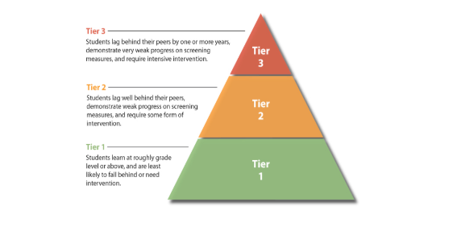
Tier 1: Universal Supports (Best practice in any classroom for all students.
Tier 2: Focused Supports
Tier 3: Essential Supports and Interventions

Slide 19
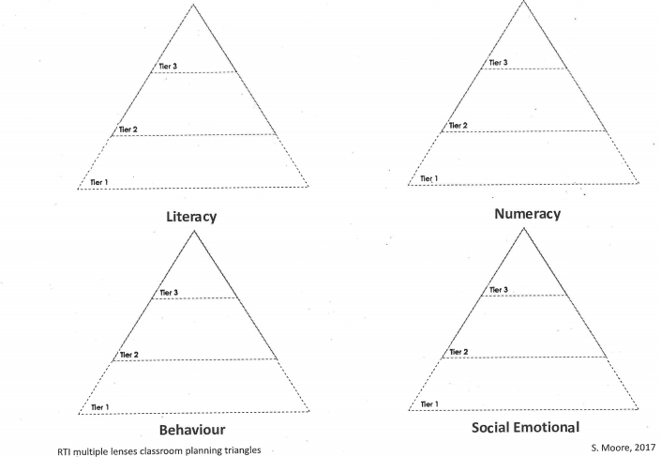

Slide 20
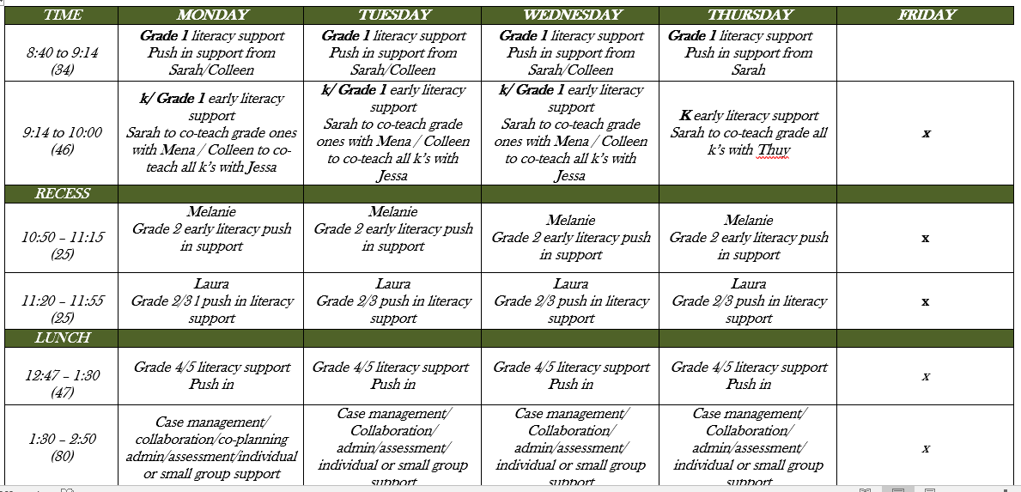

Slide 21
Literacy project results
Briefly results show:
Huge increases in mean and median scores this year as compared to the Kindergarten group at the end of 2016-2017.
K 2016-2017 K 2017-2018
Phoneme segmentation Fluency
Range 0-60 8-49
Median 23 33
Mean 22.2 29.13
Nonsense Word Fluency
Range 0-58 6-45
Median 6 16
Mean 13.8 20.43
NO very low children in the 2017-2018 cohort.
Some children have sound-letter correspondence but not sound segmentation abilities and vice versa. This has clear implications for instruction so that resource services can now be maximally effective and efficient.
We have detailed information on every child allowing best use of RtI, clarifying instructional needs and enabling clear information sharing with parents. We anticipate this will massively reduce the number of children needing resource services in later grades. We are not waiting for children to fail.
For some years leaders in reading disability research have stressed the need to attend to the bottom 50% of children. This is very clear when the data is plotted.
*** Many, many thanks to Jessa Duyndam, Mena Sihota, Collen Pommelet , Michelle Forest, Carmen Gauvreau and Murray Harris.

Slide 22
Data is important because….
Review accuracy in test administration
choice of tests and subtest decisions
decisions about what conclusions can be drawn from the data and how reliable it is
individual progress (or lack of)
class progress
qualitative analysis for skills development
RtI decisions and UDL information

Slide 23
Data K June
Phoneme segmentation fluency
June 2016-2017 (no JP)
x
x M x
x__x___x_______x_______x___x_____x___x________x__x______x_________x0 10 20 30 40 50 60
June 2017-2018 (one year JP)
x x x M x
_________x__x_x_x____x___________x__x__x_x_x_x__x_x___x__x__x___________0 10 20 30 40 50 60

Slide 24
Data K June
Nonsense word fluency
June 2016-2017 (no JP)
x
x x M
x__xx___xx____x__x__x___x___x________x________________x___________
0 10 20 30 40 50 60
June 2017-2018 (one year JP)
x
x x x x M x
_______x_x_x_x_x_x_x_x_x_________x__x__x_____x_x_x__x____x__x_________
0 10 20 30 40 50 60

